Slide 1


Measuring the
Economic Value of Research:
The Case of Food Safety
John L. King
Graduate Studies
UC Davis
Data Community Forum
March 12, 2018

Slide 2

What is the economic value of science?
It’s a hard question!
  Lots of scientists, disciplines, institutions
  University, industry, government make the
  “triple helix” of innovation and discovery
Our book is a “how to” guide…
  to link public award information…
  with university administrative data …
  and federal administrative vendor, employee data…
…to generate credible, replicable, sustainableevidence
Notes:
NSF Award # 9411306: $4,516,573.00 (The Stanford Integrated Digital Library Project)

Slide 3
Start small: USDA science funding
$2 billion per year in R&D
  About half intramural at USDA facilities
  The other half extramural, mostly Land Grant Universities
Questions:
  Is this the right amount?
  Is the intramural/extramural split right?
  How much for each topic?
    Crops, Livestock, Environment, Nutrition, Food Safety, Rural Populations
  Big projects or little projects?
  How did we do last year? The decade before that?
Notes:
The Crops Pathology and Genetics Research; 2) National Clonal Germplasm Repository for Tree Fruit Nut Crops; 3)The Western Human Nutrition Research Center

Slide 4
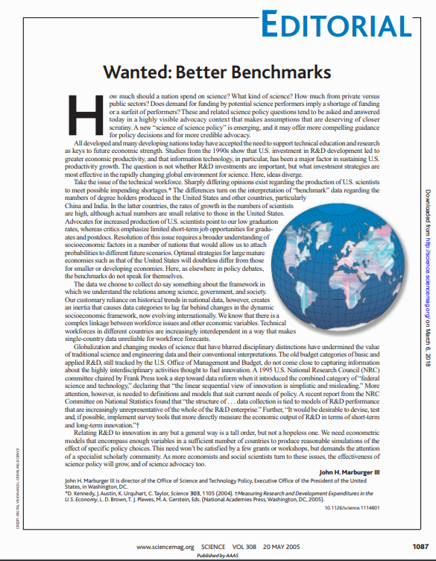
The problem is more general, and the solution more important
Call for a “Science of Science Policy”
  Science 308 (2005). “Wanted: Better Benchmarks.”
  John Marburger, Dir., Office of Science and Technology Policy
Work started…

Slide 5
Focus of today’s talk
What we did
UMETRICS/IRIS data model
How we did it
Three applications of data science to working with “big data”
Machine learning for document classification
Data linking
Working with PII

Slide 6
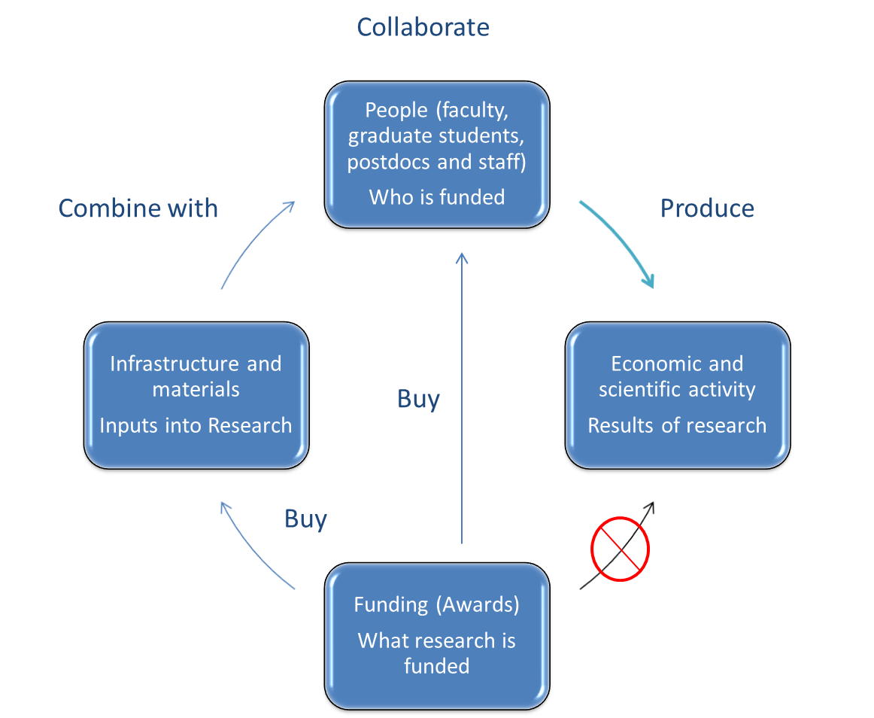
We want to
know this!

Slide 7
Funding doesn’t do science, people do
We want to
know this!

Slide 8
Funding doesn’t do science, people do
Federal
Census/ACS,
Bus. Register
Data
University Transaction Data
Federal Award Data

Slide 9
The basic concept:
Agency funding
University Account
Account Pmts
/Transactions
Individuals
Vendors
Outcomes-Firms
-Employment
-Sales
-R&D
Outcomes-Individuals
- W2 earnings
(amt,location,sector)
- Patents,
- Publications
- Start-ups

Slide 10
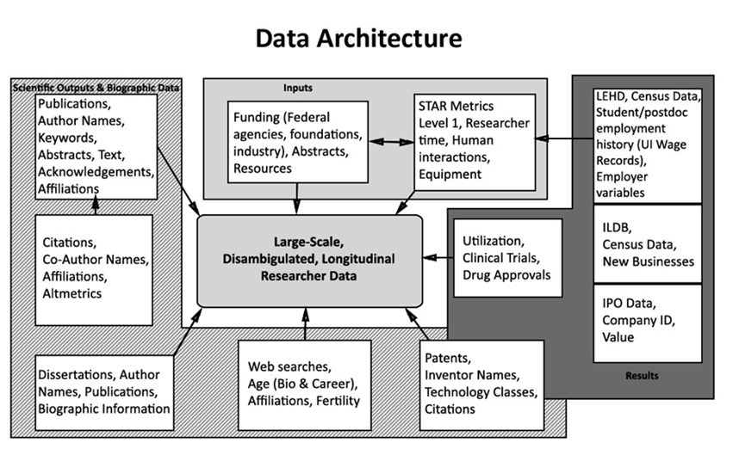
The complicated concept:

Slide 11
The basic concept:
Agency funding
University Account
Account Pmts
/Transactions
Individuals
Vendors
Outcomes-Firms
-Employment
-Sales
-R&D
Outcomes-Individuals
- W2 earnings
(amt,location,sector)
- Patents,
- Publications
- Start-ups

Slide 12
The IRIS/UMETRICS “Business Model”
Give__ | Participants | __Get__
Annual transaction data Subscription funding | Member Universities | Quarterly Impact Reports Understanding of impact
Institutional Support (Staff, IT, programming) | IRIS | Funding
PIK links/PII clearance/RDCs Analysis and expertise | Census | Research program Publications
Code, Data Improvements User funding | Policy Researchers | Access to data Publications
(User funding) | Funding Agencies | Understanding of impact Process improvements

Slide 13


Slide 14
The basic concept:
Agency funding
University Account
Account Pmts
/Transactions
Individuals
Vendors
Outcomes-Firms
-Employment
-Sales
-R&D
Outcomes-Individuals
- W2 earnings
(amt,location,sector)
- Patents,
- Publications
- Start-ups

Slide 15
The basic concept:
Three Applications
Working
with PII
Agency funding
University Account
Account Pmts
/Transactions
Individuals
Vendors
Outcomes-Firms
-Employment
-Sales
-R&D
Outcomes-Individuals
- W2 earnings
(amt,location,sector)
- Patents,
- Publications
- Start-ups
Machine Learning
Data
Linking

Slide 16
Topic 1: Machine learning for classification
The Challenge:
46,000+ NIH/NSF/USDA funded research awards at 19 universities.
How to analyze research into meaningful groups?
How to identify research projects of particular interest?
Agency, university classifications not compatible
Expert review of each award is not feasible
…not even using “Mechanical Turk” or “crowdsourced” alternatives
Problems with multidisciplinary, multiobjective projects
…especially important in emerging areas of science
The Solution:
Machine learning for document classification of research abstracts

Slide 17
Topic 1: Machine learning for classification
To use machine learning:
Get a bunch of documents (the “corpus”)
Web scraping of research.gov, NSF, NIH, FederalReporter
For each document, count the occurrence of each word
Python took 116ms to construct an “n-gram” for Moby Dick
Machine learning to assign documents to groups based on n-gram
  Wikilabeling
  Topic modeling
Human validation of results
Notes:
#!pip install gutenberg
from gutenberg.acquire import load_etext
from gutenberg.cleanup import strip_headers
from collections import Counter
MobyDick=strip_headers(load_etext(2701)).strip().lower().replace("\n"," ").replace("\'"," ").split(" ")
count = Counter()
for word in list(MobyDick):
count[word] += 1
[(k, count[k]) for k in sorted(count.keys())][100:110]
“WHALE” :604

Slide 18
Topic 1: Machine learning for classification
Multiple approaches provided a set consistent with estimates
Wikilabeling: Webscrape the Wikipedia “Food Safety” page, all links from that page, and continuing links for a convergent set of pages. Then tag documents in the corpus that are most similar to those food safety documents.
Topic Modeling: Group documents from the corpus into the most distinct topics. Find the topics with the most relevance to your area.
Search Terms: Use expertise to construct boolean searches.

Slide 19
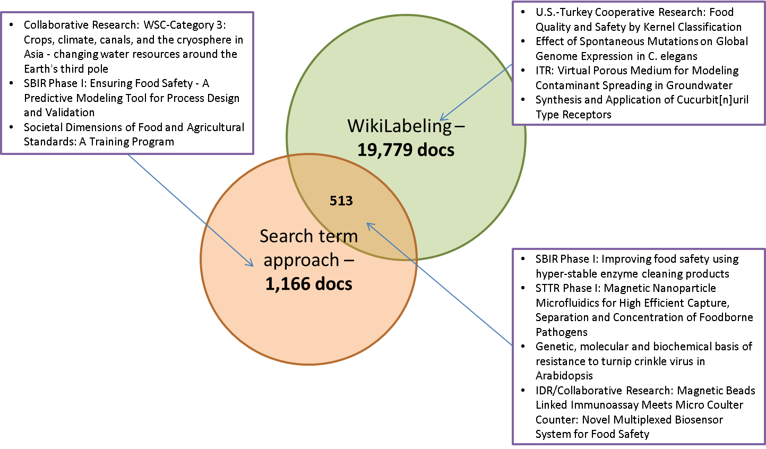
Topic 1: Machine learning for classification
Notes:
Final thoughts: Better to use a properly indexed set of information! To get a list of recent PhD graduates, I wouldn’t topic model their dissertations and deduce their disciplines… I would look up their major code in Banner! But when you are comparing different institutions, or trying to get a new look on things, machine-assisted classification can hel.

Slide 20
Topic 2: Record linking
This project depends on effective record linking, at scale.
Minimum exchange of PII to get accuracy, precision without recourse to manual matching
Blocking to minimize comparisons (or: 6.6T match candidates)
Public federal award number | → | University award numbers
University deidentified individuals, vendors | → | Census unique identifiers for individuals, vendors (and other federal admin data!)
University individual names | → | Research outcome databases: Publications (incl ProQuest dissertations) Patents

Slide 21
Topic 2: Record linking
Linking graduate student/postdoctoral scholar data to ProQuest dissertation abstracts provides another level of outcome analysis
Alignment of dissertation research with GSR appointments
Timing of dissertations relative to research activity
Relative frequency of dissertations by field
ProQuest Dissertation Topic by Agency Source of Support
NIH |  | NSF |  | USDA
Subject | Proportion | Subject | Proportion | Subject | Proportion
Biology | 37.97 | Engineering | 38.27 | Agriculture | 29.17
Health | 18.43 | Mathematics | 11.86 | Biology | 18.75
Engineering | 15.00 | Biology | 7.88 | Engineering | 13.89

Slide 22
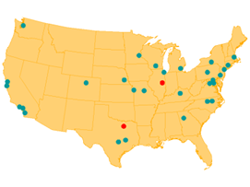




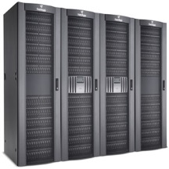

Topic 3: Working with PII

Slide 23
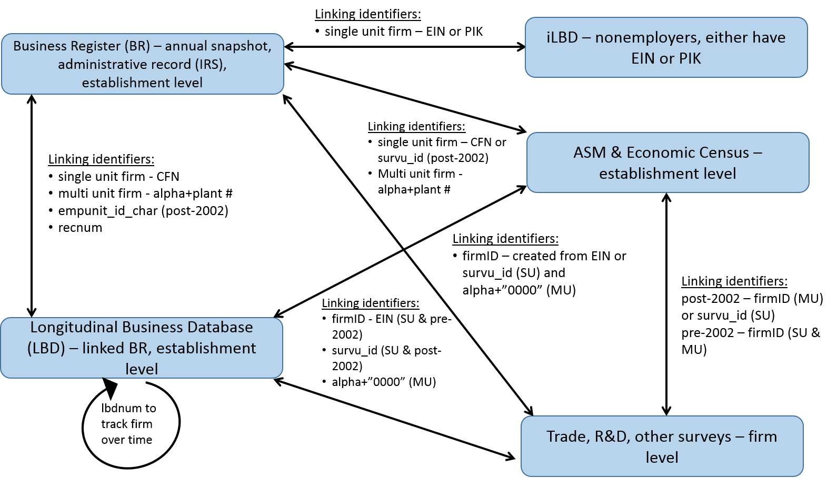
Topic 3: Working with PII
The main tool for maintaining confidentiality and deidentification of data is the Protected Identification Key (PIK). Generally a DOB and complete name are sufficient to establish a PIK for an individual.
Firms are more difficult to track, due to multiple locations and ownership structures.

Slide 24
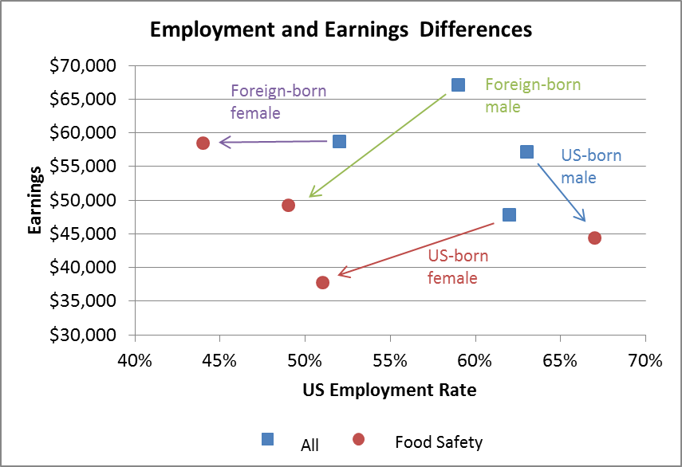
Finding: Food safety researchers earn less than peers, foreign-born less likely to work in US

Slide 25

There is an active and growing research community around the IRIS/UMETRICS data
http://iris.isr.umich.edu/
https://www.census.gov/ces/
https://www.census.gov/fsrdc/
https://www.aau.edu/education-service/service/economic-impact
contact:
jhnking@ucdavis.edu

