Slide 1
Budget Context
October 28, 2019

Slide 2
Budget Office
Budget Office Mission: provide effective policy and financial analysis to ensure the sound stewardship and strategic use of campus resources.
Manage annual budget process
Process to align available resources with campus mission and strategic goals
Identify available resources and challenges or opportunities
Campus resources are allocated through both formulas and strategic decisions
Overall campus budget and unit budgets are finalized
Notes:
SM

Slide 3
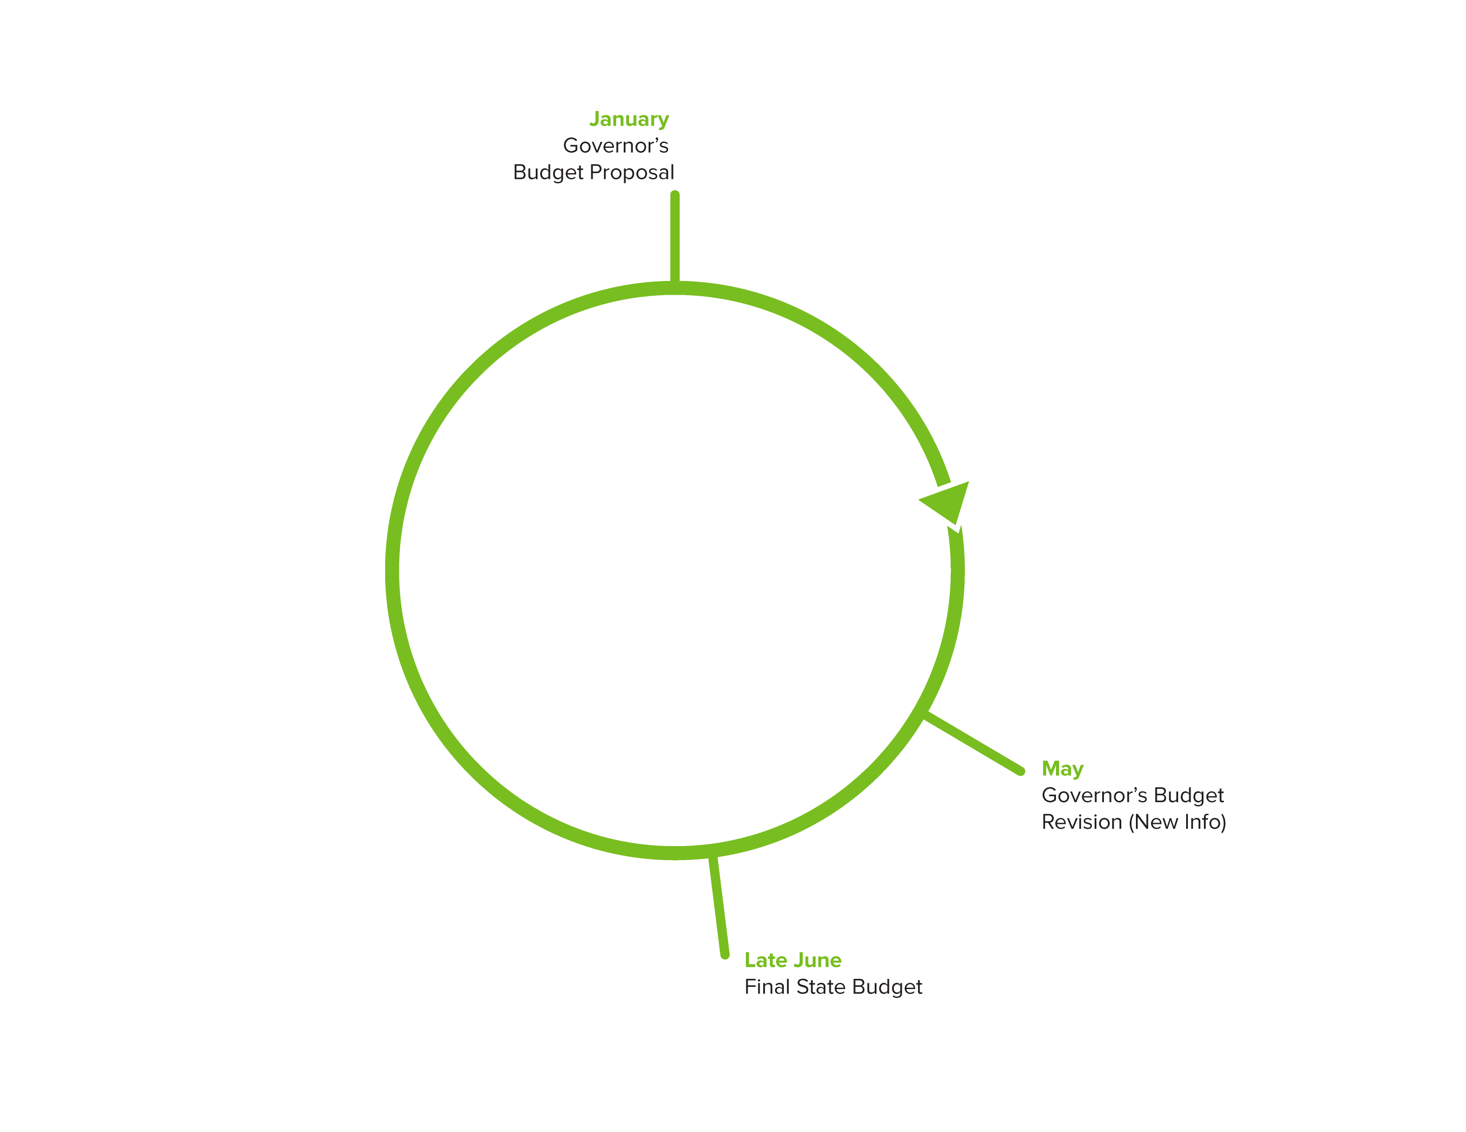
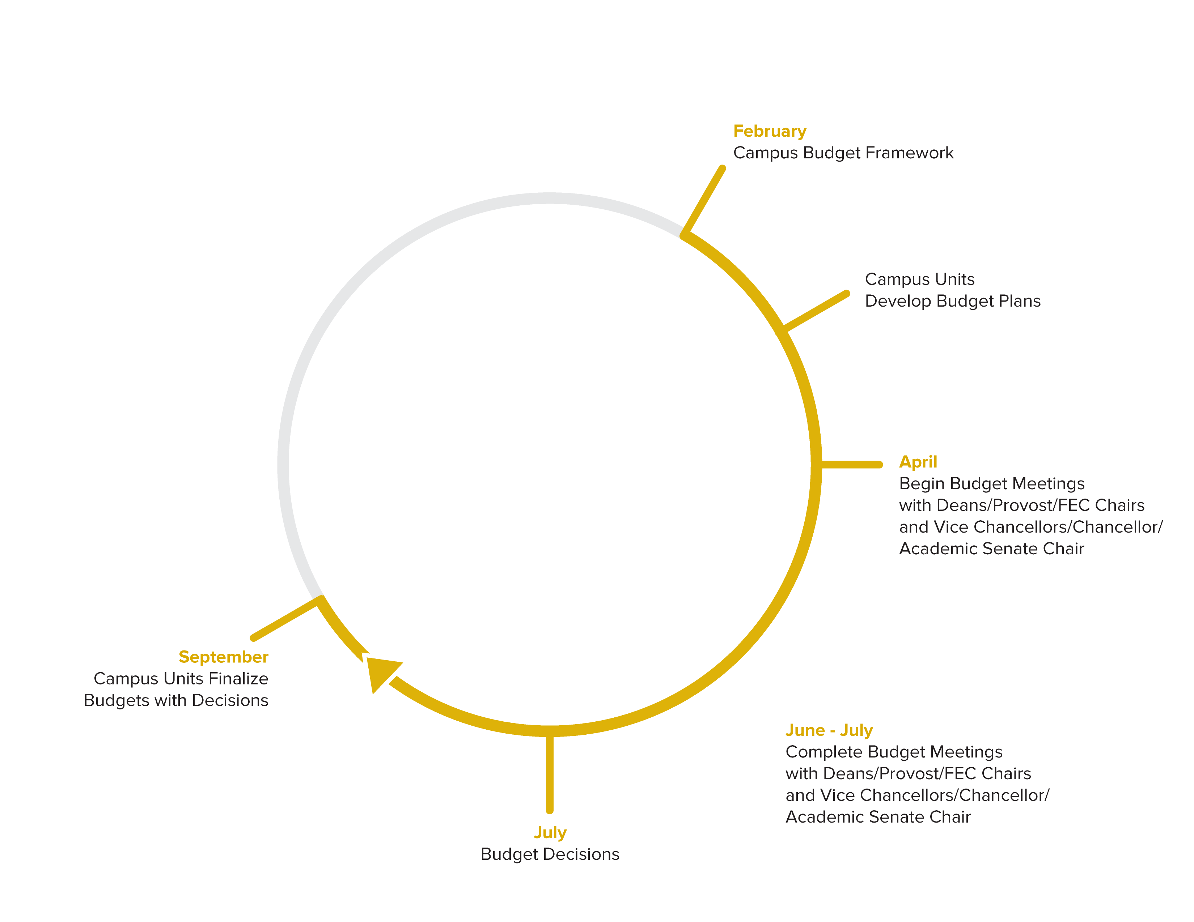
UC Davis Budget Planning Cycle
UCOP
State of CA
UC Davis
Notes:
Sarah

Slide 4
AggieBudget is a budget, financial forecasting and reporting solution designed to improve efficiency and transparency in resource planning and management at UC Davis.
Goals:
Replace Excel-based, ad hoc budgeting and reporting
Provide consistency
Increase transparency
Contribute to the financial health of the organization at all levels
Support greater confidence in investment in unit/university priorities
Improve and support communication around budgets and long-term planning
Less time spent on technical budget and report development and more time spent on analysis of options and outcomes.
Support multi-year planning at all levels

Slide 5
Goals of Budget Context Conversion Project
Facilitate decision making
Increased transparency
Easer to update, significant reduction in staff time and effort
Earlier updates
Automation reduced errors
Consistent formats & information
Ability to see trends and choose most relevant views to user
Notes:
SM – Show binder?

Slide 6
AggieBudget Data Extract Approach
AggieBudget consumes data from KFS and is the system of record for budget data
Conversations around data extraction
No direct connection option
AB transforms KFS transactional data and adds new dimensions
Table structure includes tables for each year for several data sets
Lots of look up tables
Options
All tables in data warehouse
Massive table in AB to export
Notes:
TW – add viz of table relations

Slide 8
Transforming Source Data for Tableau
Refactoring the AggieBudget Extract (CSV)
Joining the Sub Fund Group Type look-up table

Slide 9
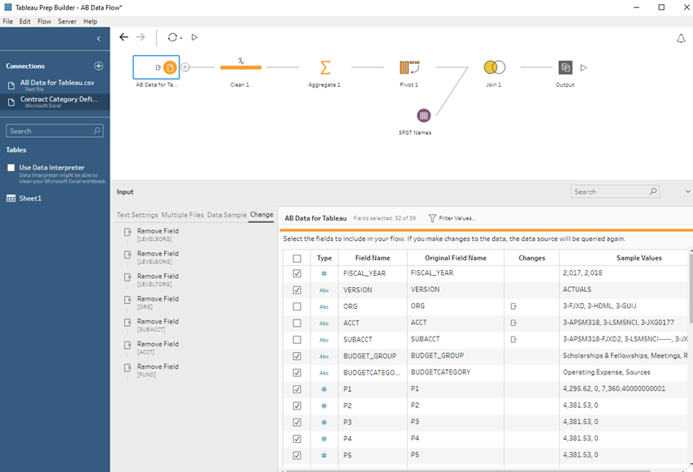
Using Tableau Prep – Connect to .CSV, Filter Columns

Slide 10
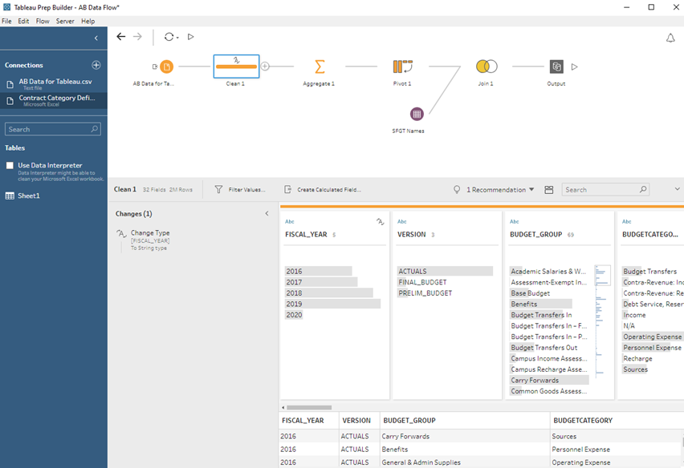
Tableau Prep - Changing the Data Type

Slide 11
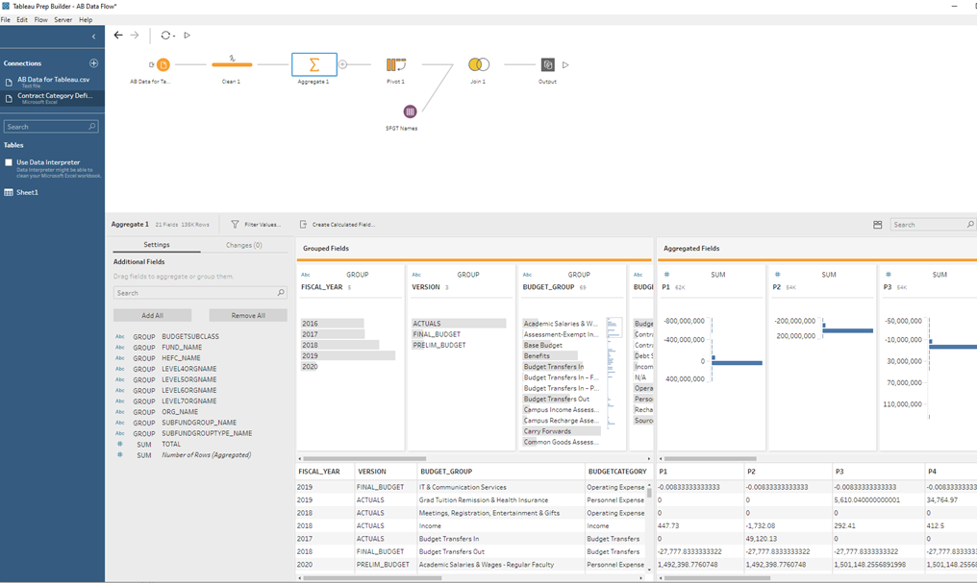
Tableau Prep – Aggregate to relevant level of detail

Slide 12
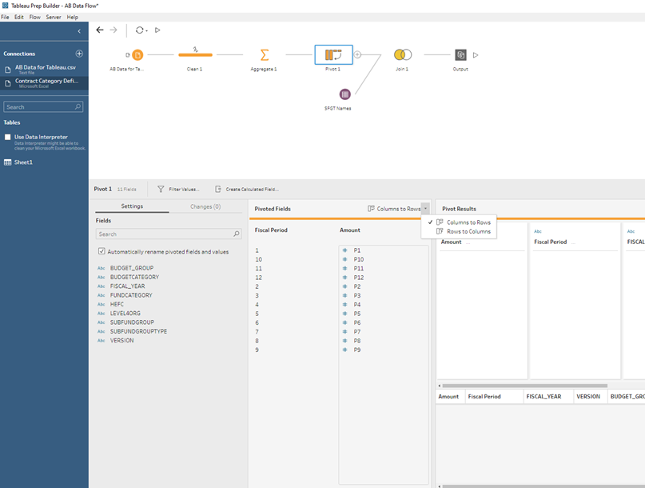
Tableau Prep – Pivot Columns to Rows

Slide 13
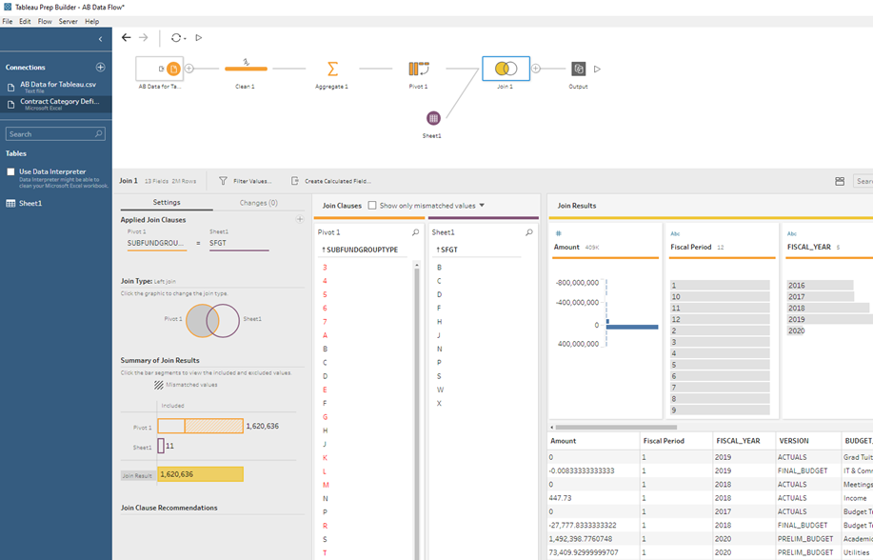
Tableau Prep – Join on descriptor look-up table

Slide 14
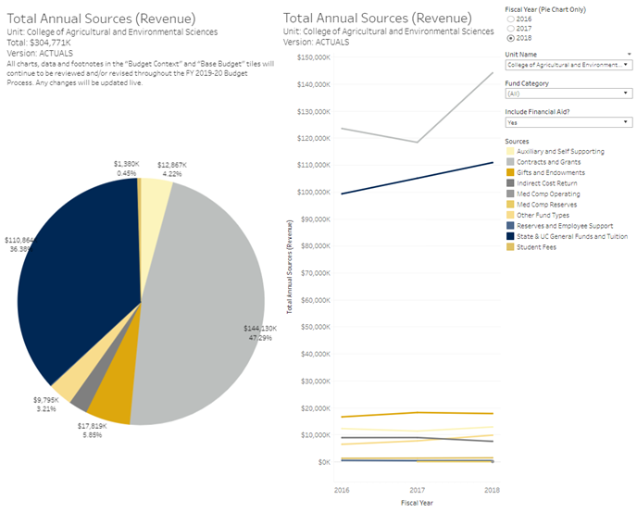
Dashboard from the refactored data

Slide 15
Data Journey - Endowments
Report on market value over the previous year
Endowments and Funds Functioning as Endowments
Endowments can be invested with either the UC Regents or the UC Davis Foundation
Two sources of data
Benefiting unit is assigned at the time the gift is received
Departments and programs do not always stay in the same place
Previous process required manual adjustments of Foundation data by Finance and Budget
Adding information on categories
Notes:
TW

Slide 16
Data Journey - Endowments
OP Fund: | 34124 | AGR TEACHER ENHANCEMENT FELSHP
Historically mapped to Graduate Studies
Expenditures are in School of Education
The fund's STIP account is in College of Ag
Notes:
TW

Slide 17
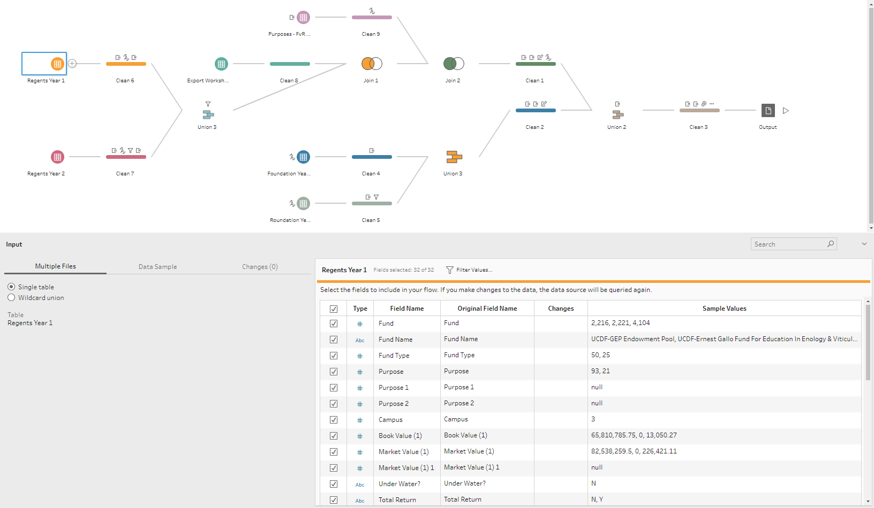

Slide 18
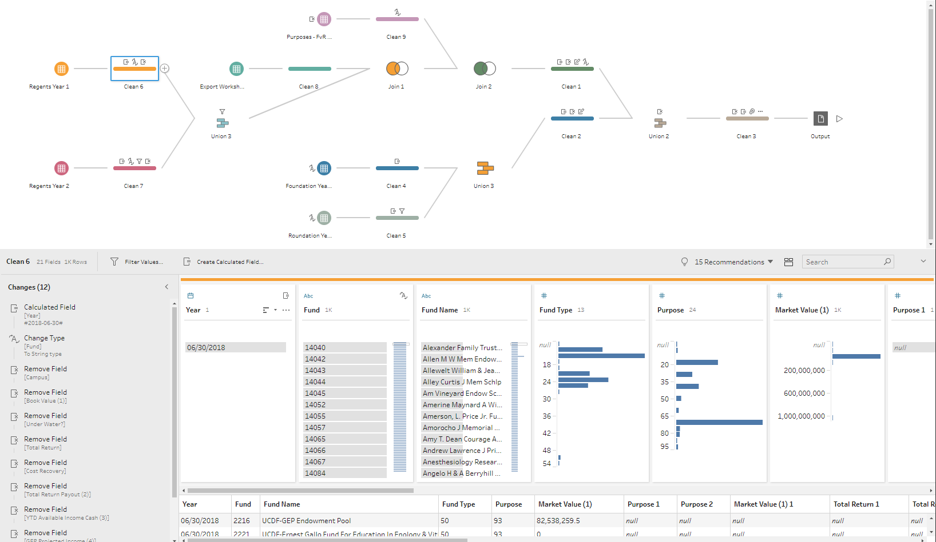

Slide 19
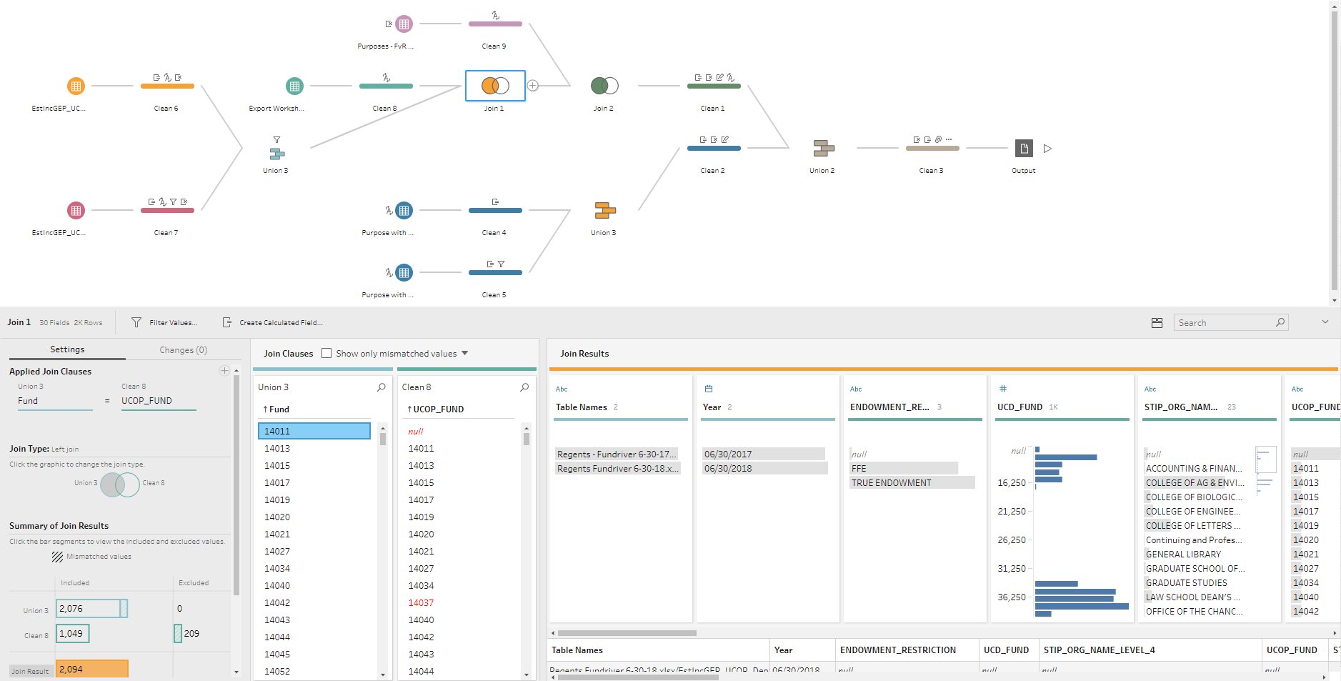

Slide 20
Adding Context – Historical YTD Comparator
Provide a comparable measure to YTD
Tableau's Level of Detail (LOD)
Total Indirect Costs
Filter to pre-April data in each year

Slide 21
Creating Aliases
Units
2400 = College of Engineering
3-ATHL = Intercollegiate Athletics
COLLEGE OF BIOLOGICAL SCIENCES = College of Biological Sciences
Notes:
AG

Slide 22
Examples of Groupings

Slide 23
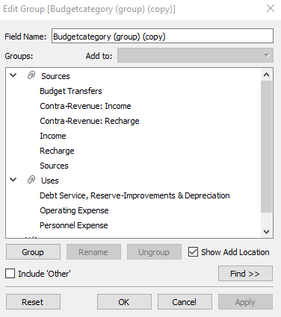
Examples of Groupings
Budget Category Groupings
Notes:
AG

Slide 24
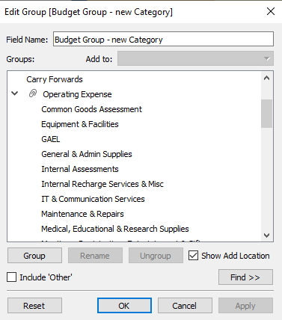
Examples of Groupings
Budget Group Groupings
Notes:
AG

Slide 25
UC Davis Color Palette
Business Intelligence Website
Step-by-step instructions for onboarding the UC Davis color palette onto Tableau Desktop
https://financeandbusiness.ucdavis.edu/bia/b-i/tableau/blog/ucd-color-palette
Notes:
AG

Slide 26
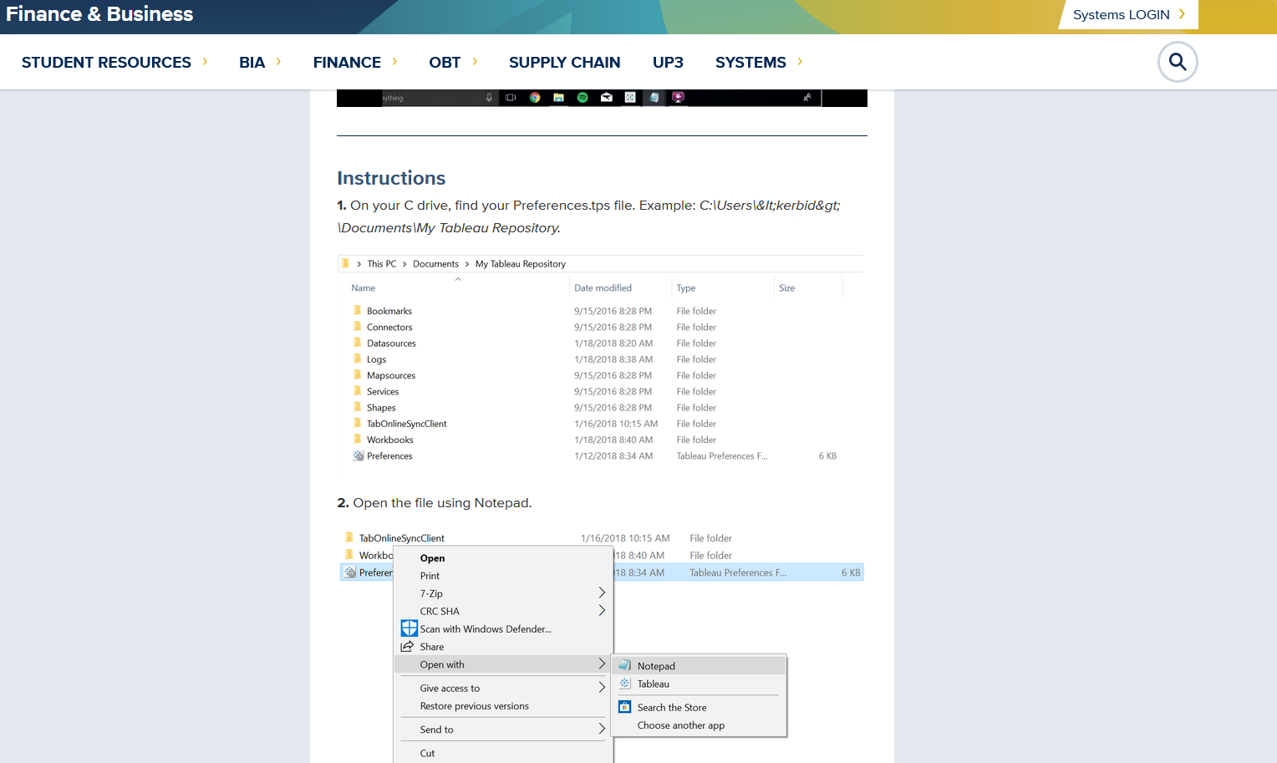
UC Davis Color Palette
Notes:
AG

Slide 27
UC Davis Color Palette
Notes:
AG

Slide 28
Results
Binder replaced by tip sheet for users
AggieData.ucdavis.edu > Budget
Eliminated long pdf file on website
Now in a location where all data is kept: easier to find and use
Used in wider variety of meetings: example Senate Committee meeting
Users are coming to expect this level of access to data
Staff able to spend time on new projects and add to available data and information, rather than updating existing reports
Notes:
SM

Slide 29
Benefits
KFS does not have complete and approved budget data, only AggieBudget does. Now able to integrate data from systems.
KFS and AggieBudget only available to limited users. AggieData is available to whole campus community and public.
Consistent definitions and view of data. So many options in KFS often can get different answers to same questions.
See how central campus is viewing your data.
Notes:
SM

Slide 30
Questions?
https://aggiedata.ucdavis.edu/ Budget+

