Slide 1
TECHNOLOGY, ENGINEERING AND DATA CONTINUING AND PROFESSIONAL EDUCATION
Courses for professionals in the Sacramento Area
Alex Lowrie: awlowrie@ucdavis.edu
John Dolan: jjdolan@ucdavis.edu

Slide 2





Sacramento Tech Jobs Landscape
Product
Managers
Business Requirements
Computer
Systems
Analysts
1158
Information
Security
Analysts
BI Analysts
UI/UX
Designer/
Developer
Web
Developers
IT Project
Managers
Systems
Engineers/
Architects
Database
Architects
Citizen Data
Scientists
Application
Development
Systems Development
Analytics Development
Computer
Programmers
Software
QA
Computer
Network
Architects
Software
Developers,
Systems SW
Data WH
Specialists
Computer
User Support
Specialists
Software
Developers,
Applications
Support
Network &
System
Admins
Database
Admins
Network
Support
Specialists
Key
Operations
= 100 jobs

Slide 3
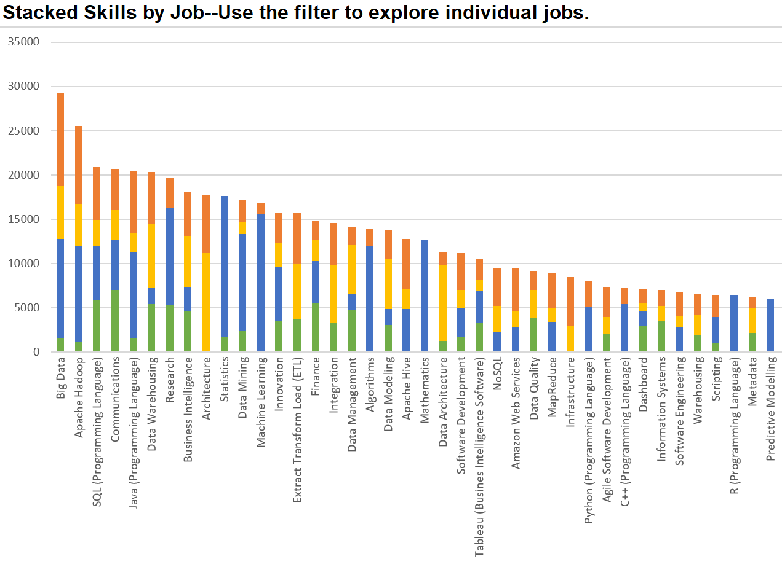
Top Skills for Four Specialist Data Roles

Slide 4



Tech Engineering Data [TED] Portfolio
Learner Is…
Tech
Data
Specializing
Blockchain /
FinTech
Cloud
Machine
Learning
Data
Engineering/
Big Data
Career Changing
Full Stack
Development
Cyber Security
Data Analytics
Web
Development
Data Analytics
for Insurance
Data Analytics
for X
Career Enhancing
Web Design
Data Science
Fundamental
Skills
DevOps
Secure
Programing
Data
Visualization
SQL for
Data Science
Key
Live
Web
Development
Computational
Social
Science
In Development
Proposal
Concept

Slide 5
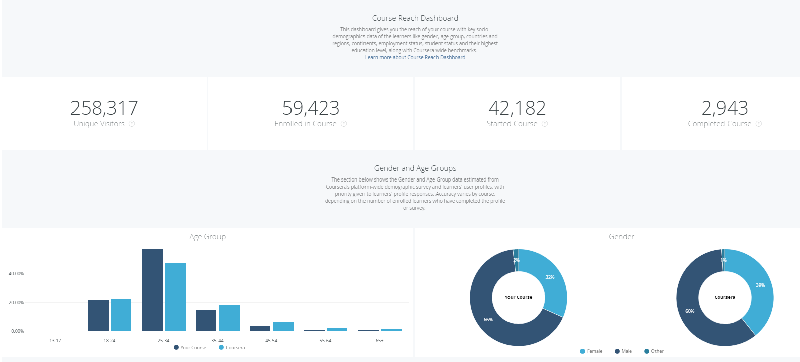
SQL for Data Science—Coursera Data

Slide 6
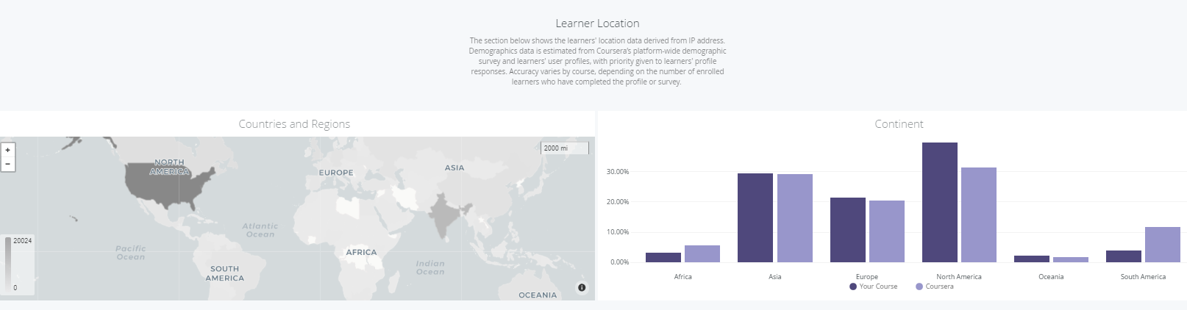

Slide 7
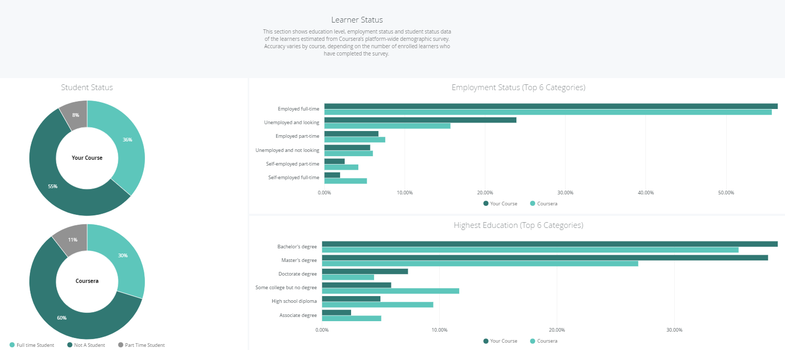

Slide 8
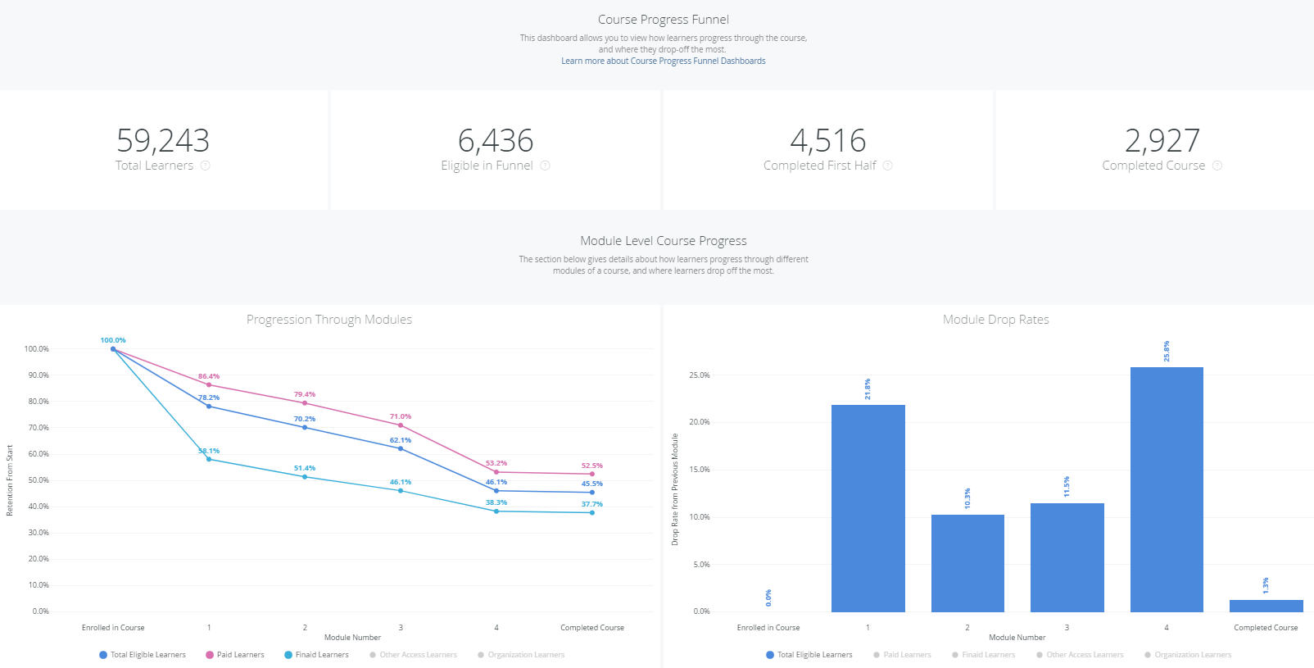

Slide 9
Thank You!
Alex Lowrie: awlowrie@ucdavis.edu
John Dolan: jjdolan@ucdavis.edu

